Slide 1



Our website
AAAutó autókereskedés

Slide 2
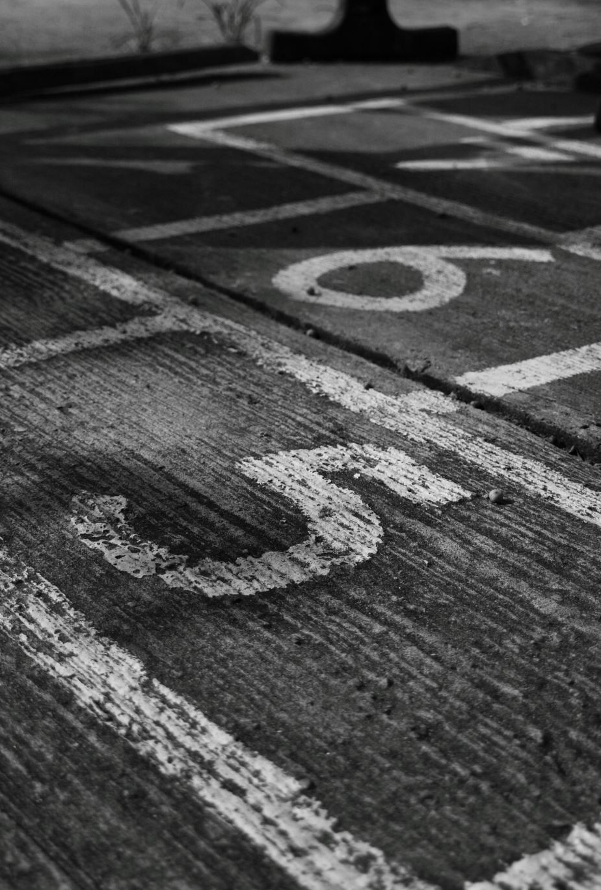
Starting:

Slide 3
Sharing work:

Slide 4
Majlát’s work:

Slide 5
Kristóf’s work:

Slide 6
Lili’s work:

Slide 7

Gathering plus information:

Slide 8
Final adjustments and discussion

